Slide 1

A Neural Network Based Model of Biomass Gasification in Fluidized Bed Reactors
Mohsen Dirbaz
Illinois Institute of Technology
Chicago, Illinois
Feb 2020

Slide 2
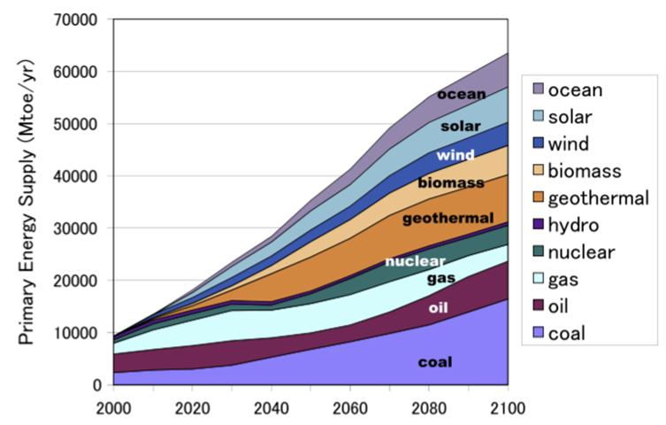
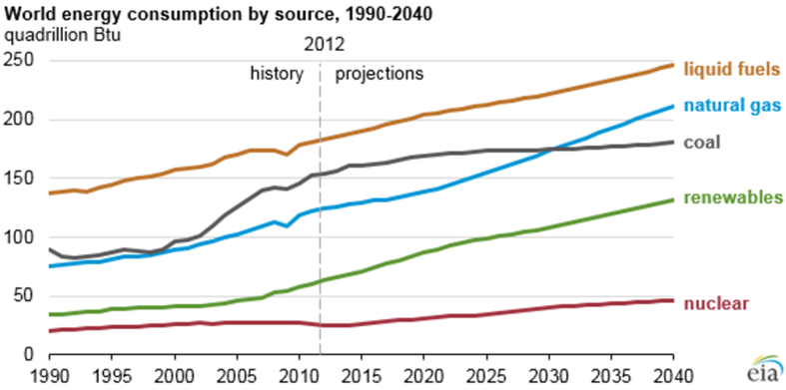
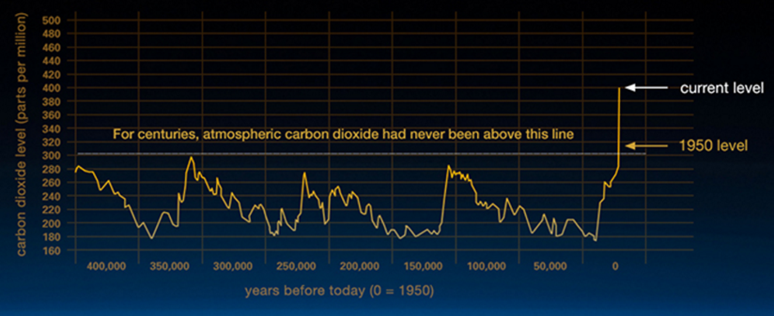
Energy security of the world & Sustainable climate
Dominance of fossil fuel in providing energy of modern life
The necessity of promoting alternatives of fossil fuel
Spike in CO2 level
Earth's surface temperature could exceed historical values as early as 2047
Utilization of biomass + Forestation = Carbon negative
Population of the world projected to exceed 9 billion by 2040

Slide 3

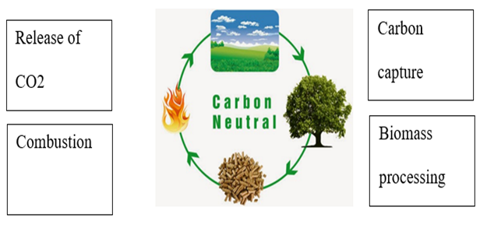
Biomass origin
Biomass phase composition
Natural
Anthropogenic
Organic matter
Inorganic matter
Fluid matter
Authigenic
Technogenic
Solid- non crystalline
Solid crystalline
Liquid
Detrital
Solid crystalline
Solid semi crystalline
Gas
Q: What is Biomass?
Solid amorphous
Fluid
Biomass groups
Ref: S.V. Vassilev et al./ Fuel 89 (2010) 913–933)
Ref: S.V. Vassilev et al./Fuel 94 (2012) 1–33
Woody
Herbacious
Aquatic
Animal waste
Municipal solid waste

Slide 4
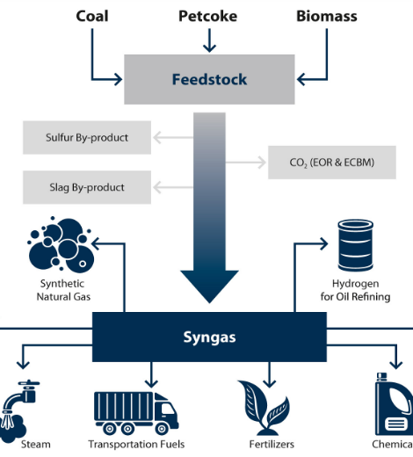
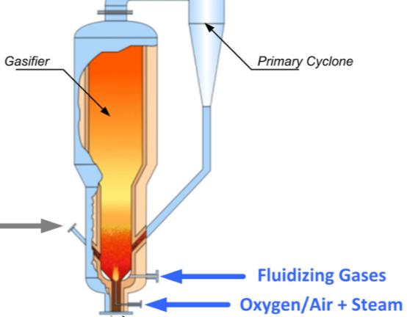
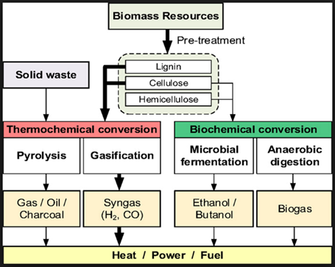
Versatility of Gasification Process
Flexible feedstock
272 operating gasification plants worldwide with 686 gasifiers.
74 plants under construction worldwide that will have a total of 238 gasifiers
33 gasification plants in the United States.
Variety of products
Pre-combustion carbon capture
Source:

Slide 5
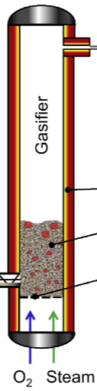
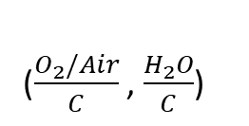
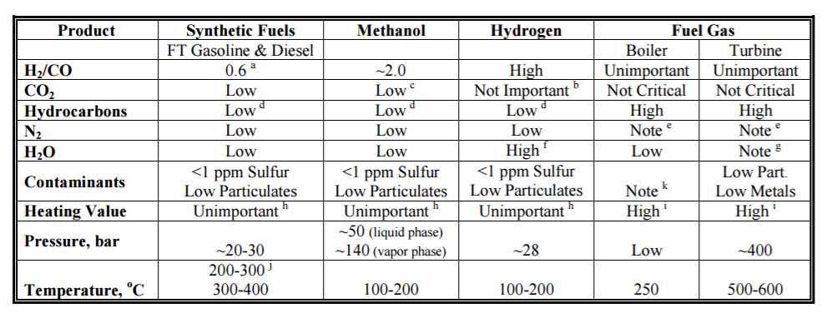
Producer gas
Wood and woody biomass
Clean up system
P & T
Birch wood
Aspen
Oak
Pine
Spruce
…
Liquid fuel
Hydrogen
Herbacious and agricultural biomass
Solid fuel
Methanol
Bamboo
Grass
Sugarcane
Swtichgrass
Power
Oxidizing agent
Contaminated biomass
Syngas specs for various applications
Municipal solid waste
Sewage sludge
Refused-drived fuel
Paper pulp
Blend of biomass

Slide 6
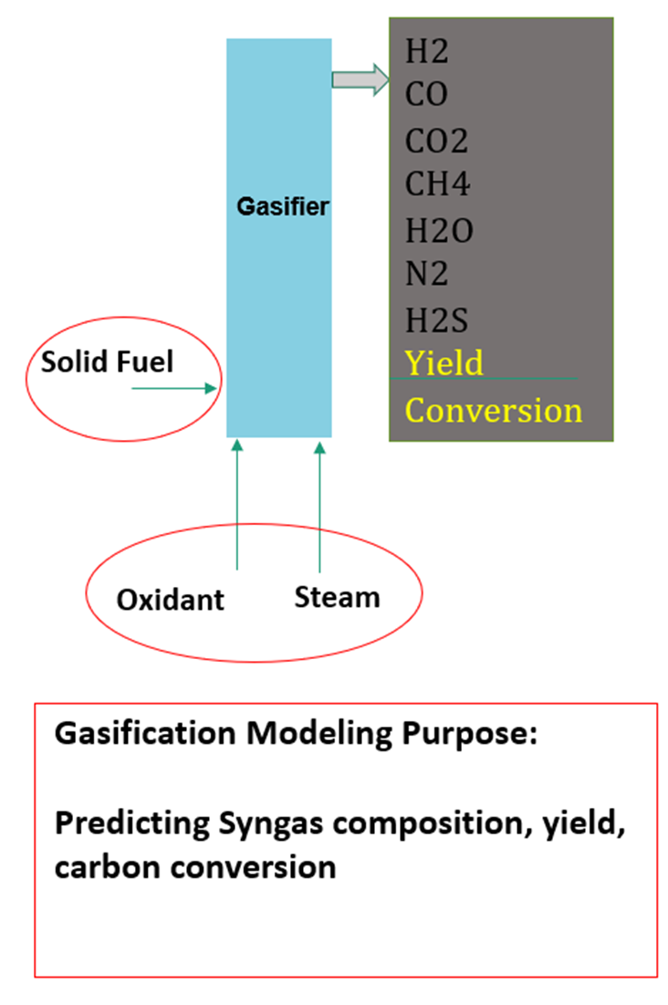
The necessity & challenges of modeling
Wood and woody biomass
Birch wood
Aspen
Oak
Pine
Spruce
Biomass composition
Ultimate analysis (C, H, N, O, S, Cl)
Proximate analysis ( Volatile matter, Fixed carbon, Ash)
Structural components (Celluloses, Hemicellulose, Lignin)
Ash composition (SiO2, CaO, K2O, P2O5, Al2O3, MgO, Fe2O3, SO3, Na2O, TiO2)
Herbacious and agricultural biomass
Physical property
Bamboo
Grass
Sugarcane
Swtichgrass
True density
Bulk density
Particle density
Porosity
Particle size
Moisture content
Contaminated biomass
Municipal solid waste
Sewage sludge
Refused-drived fuel
Paper pulp
Thermal property
Calorific value
Reactivity
Thermal conductivity
Thermal diffusivity
Blend of biomass

Slide 7
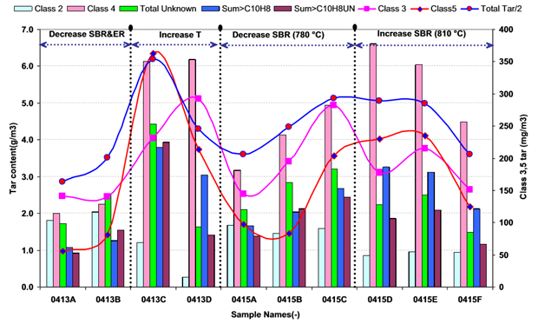
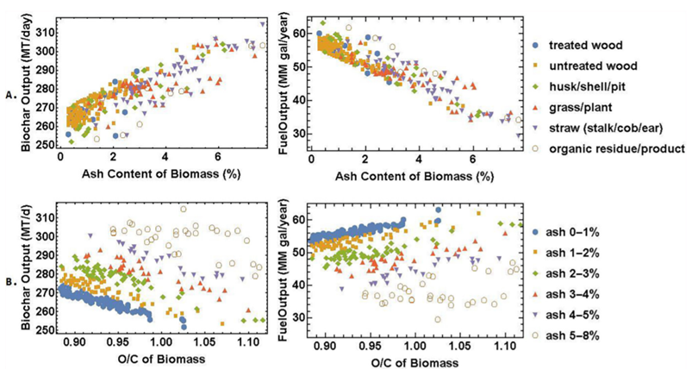
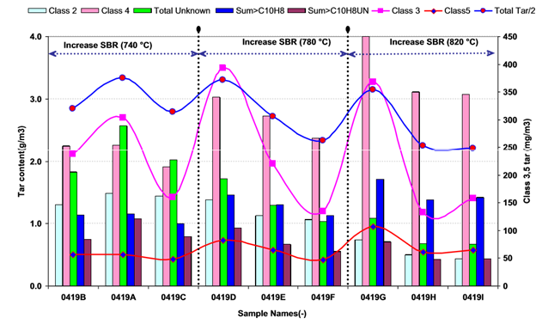
The scatter of behavior of different fuels over various conditions

Slide 8
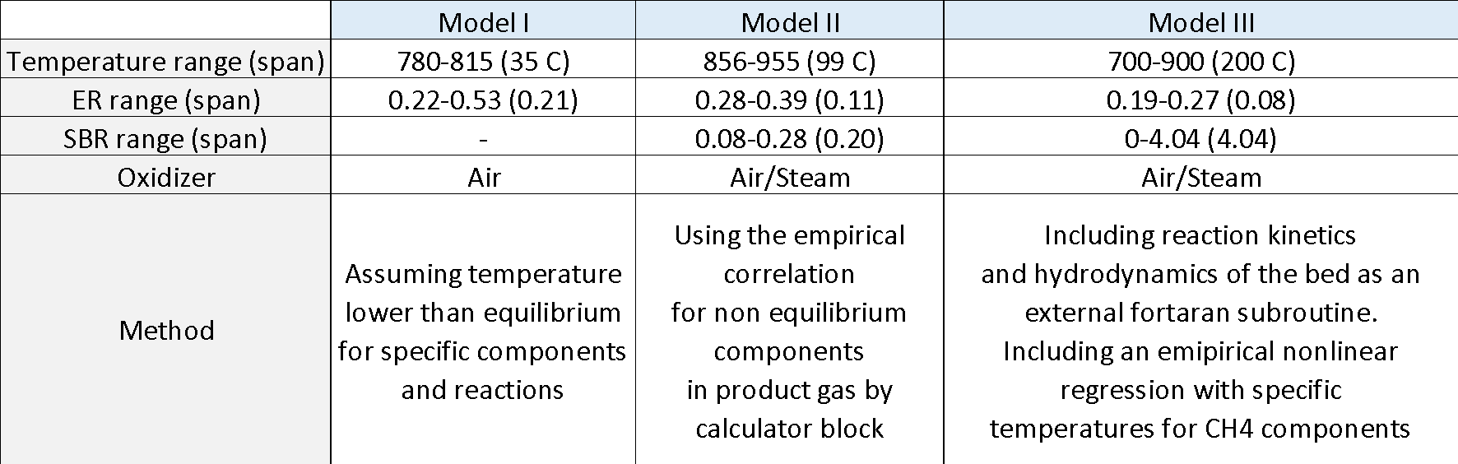
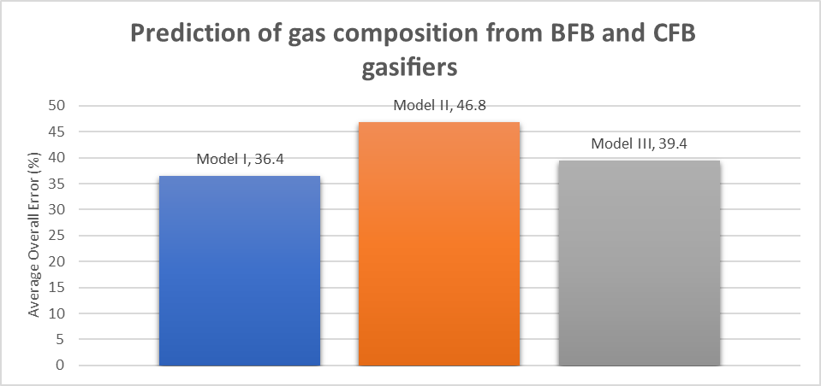
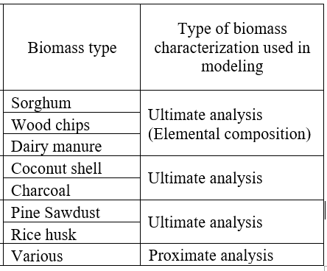
Shortcomings of existing models
Simplified: Equilibrium
Modified equilibrium: Using empirical correlations
CFD requires accurate Kinetics of the process which is hard to obtain.
Limitations in terms of type of fuel and range of applicative operating conditions
Model Ref | Temp | Feedstock | Remarks
[25] | 1073-1573 | Sewage sludge- SB coal | Equilibrium based-BFB
[26] | 920-1323 | Biomass: beech chips | Equilibrium based-Dual bed
[27] | 1273-1323 | Agricultural waste | Equilibrium based-BFB 2 zones
[28] | 700-900 | Pine sawdust size: 0.25-0.75mm | Fluidization model-Based on modiﬁed Two-Phase Theory
[29] | Not reported | Woodchips-Almond Shell Grass Straw Cornstalk RDF pellets | Fluidization model-Based on Two-Phase Theory-Reaction only in the emulsion phase
Lack of accuracy

Slide 9
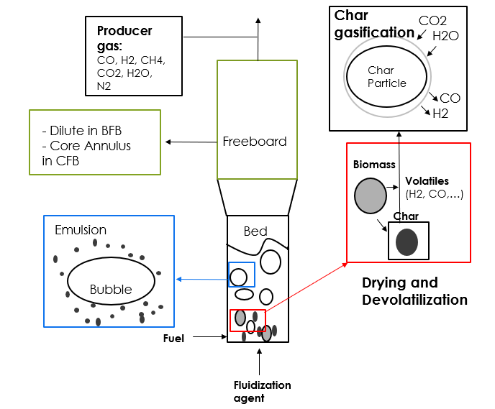
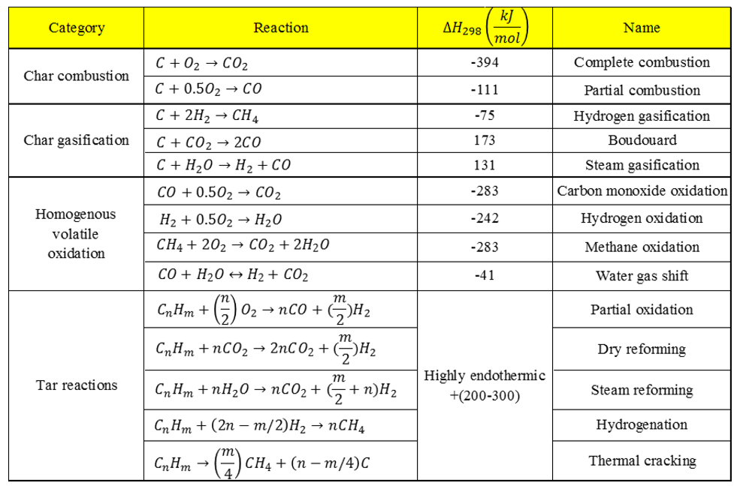
Complex dynamics
Diagram adapted from Gomez Progress in Energy and Combustion Science 36 (2010) 444–509

Slide 10
The state of experimental data
Amount of reliable gasification data is limited
Commercial
Pilot/PDU
Laboratory/ theoretical
Missing information in data sets
Product gas flow rate
Steam in product gas
Oxygen/steam feed
Minor constituents (e.g. H2S, COS, HCN, HCl…)
To complete the data sets:
Use assumption/heuristics
Close material balance
Develop heuristics/correlations (i.e. WGS, Methanation)

Slide 11
Objective statement
The overall objective of this study is:
to develop a general model for biomass gasification in fluidized bed suitable for first stage analysis capable of predicting:
Product gas composition (Vol%)
Yield (Nm3/kg)
Carbon conversion efficiency (CCE%)
by adopting effective strategies to cope with complex dynamics of the process, limitation of experimental data, and lack of proper characterization of solid fuel.

Slide 12











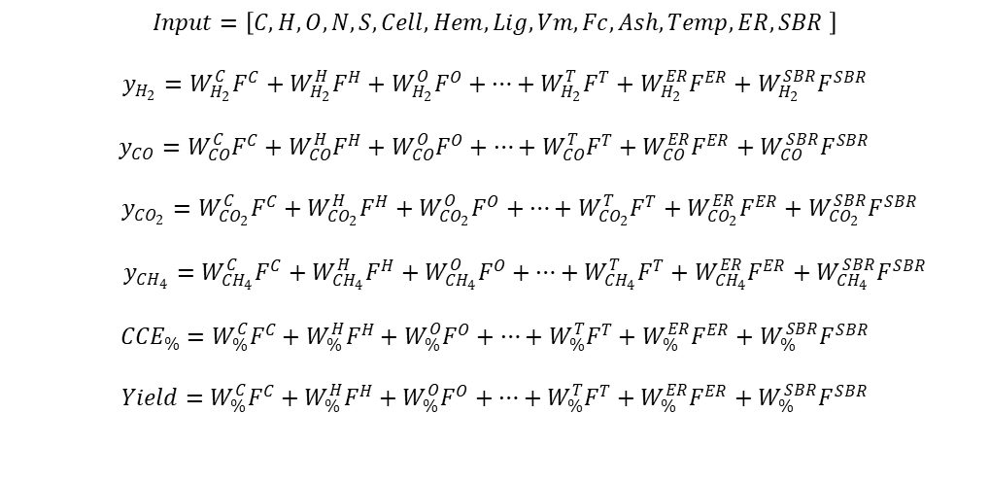










Combination of interaction between variables: single, binary, tertiary, and etc.
4
3
2
Gasifier
5
1
2
1
3
Presence of multiple interrelated groups of variables impacting the gasifier output

Slide 13

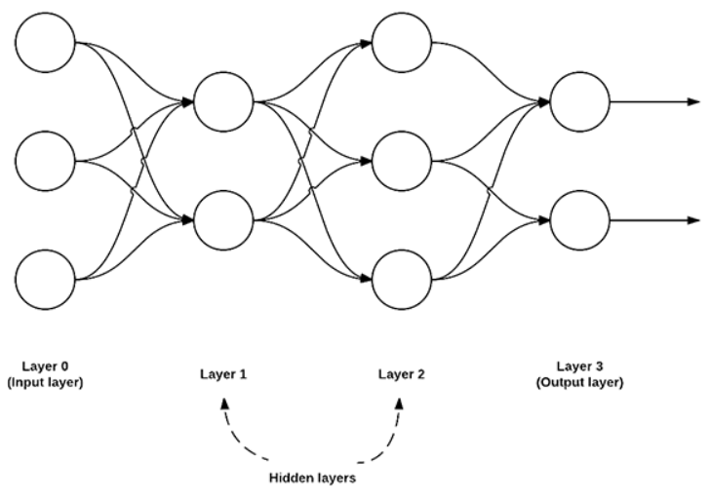
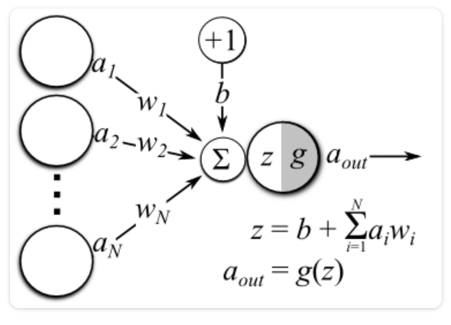
Neural Network: A computer system modeled on the human brain and nervous system with applications in:
Healthcare
Automotive
Finance & Economics
Video games
Military
Audit
…
A feedforward neural network with:
Three input nodes,
A hidden layer with 2 nodes,
A second hidden layer with 3 nodes,
And a final output layer with 2 nodes.
(Ref:Adrian Rosebrock/pyimagesearch)
Diagram of a single-layered artificial neural network.
(Ref: theclevermachine)

Slide 14

“If I were starting out today and looking for the same kind of opportunity to make a big impact in the world, I would consider three fields.
One is Artificial Intelligence…
The second is Energy…
The third is Biosciences…”
Bill Gates,
Addressing Class of 2017
A Neural Network Based Model of Biomass Gasification in Fluidized Bed Reactors

Slide 15
Modeling approach
Development of a diverse and comprehensive database & preprocessing data and resolving quality issues
Biomass characterization
Methodically using machine learning algorithms, trigonometric and geometric transformations for the purpose of “variable reduction”

Slide 16
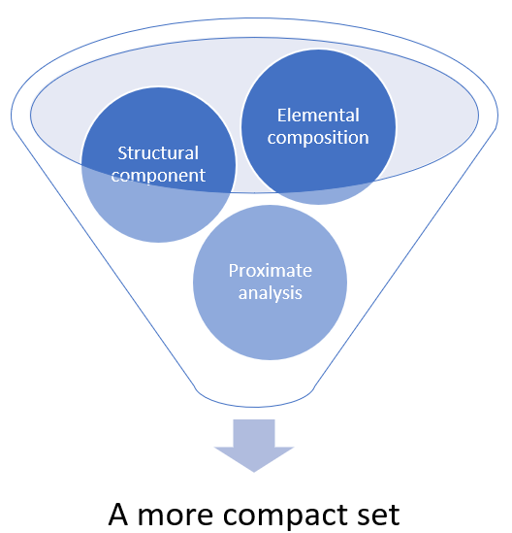
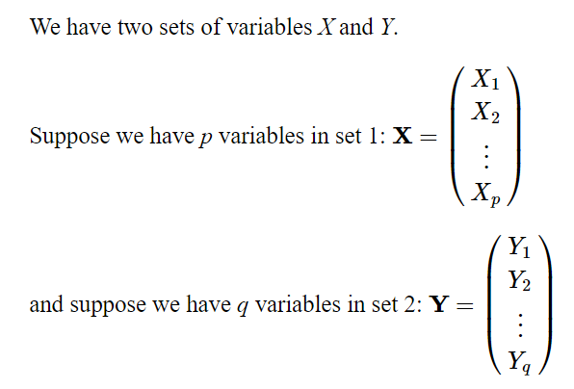
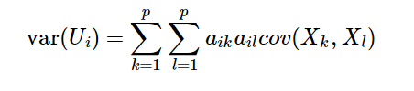

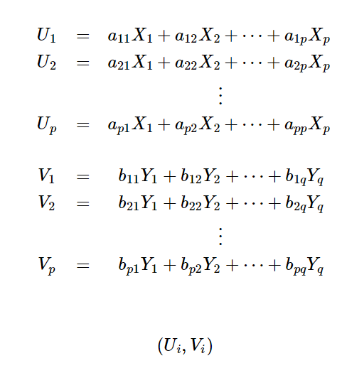


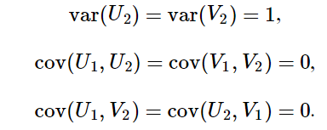
Biomass characterization using Canonical Correlation Analysis (CCA)
[E1, E2, P1, S2]
Dimensionless Indices representing their class or perspective on the feedstock:
Elemental Composition Quotient (E),
Proximate Composition Quotient (P),
Structural Composition Quotient (S).

Slide 17
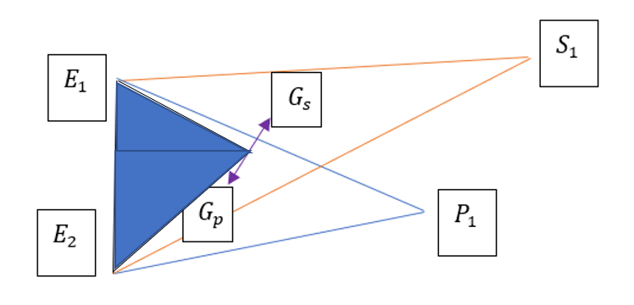
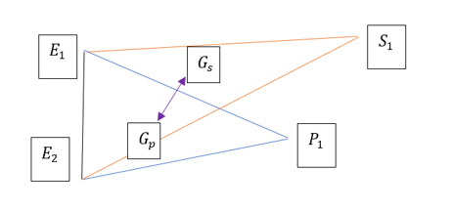
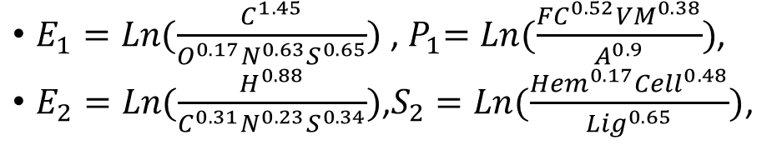
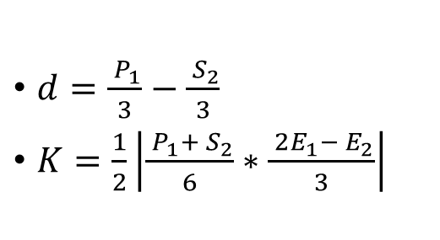
Construction of geometric objects to reduce the vector of [E1, E2, P1, S2] to [d, K]
K
d
[E1, E2, P1, S2]
Dimensionless Indices representing their class or perspective on the feedstock:
Elemental Composition (E),
Proximate Composition (P),
Structural Composition (S).

Slide 18
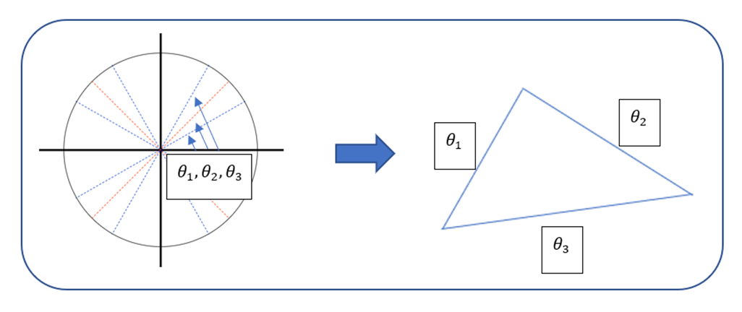
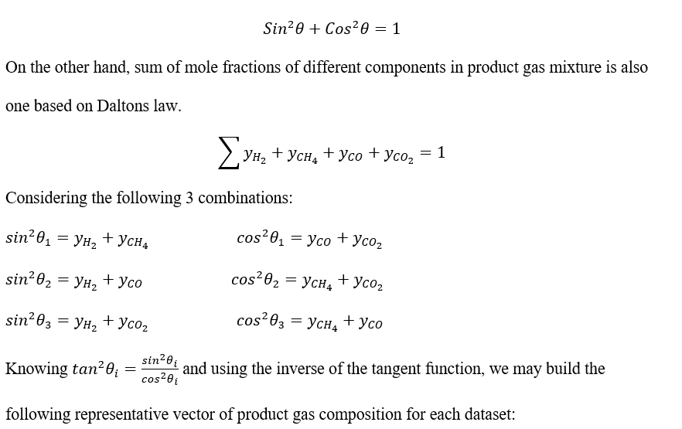
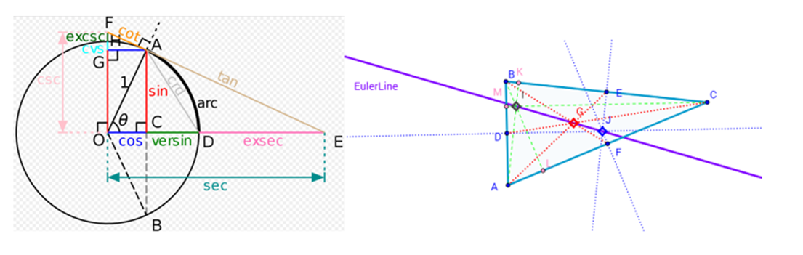
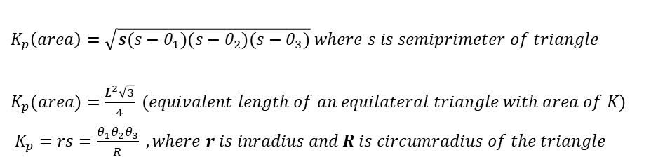

Product gas representation using
Dalton and trigonometric Identities

Slide 19
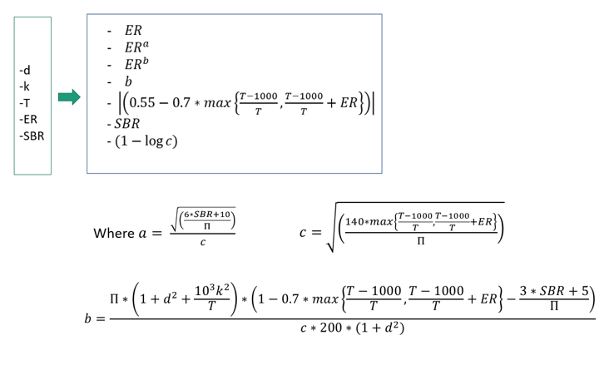
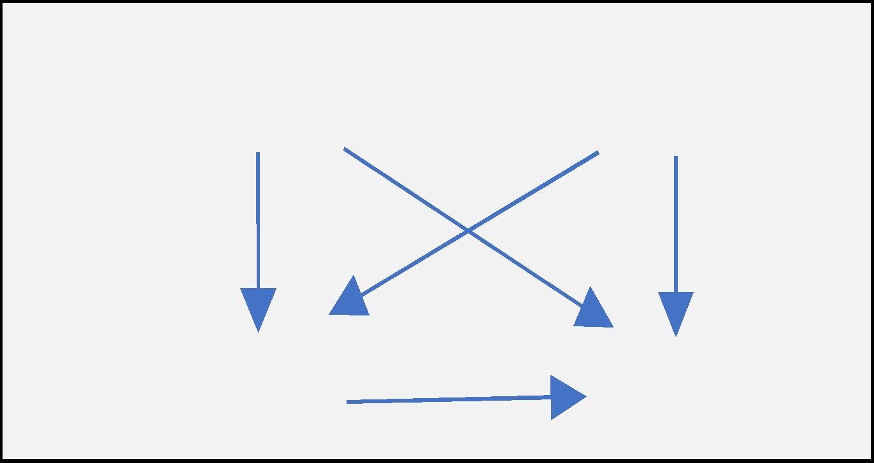
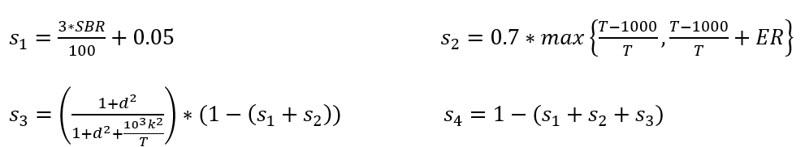
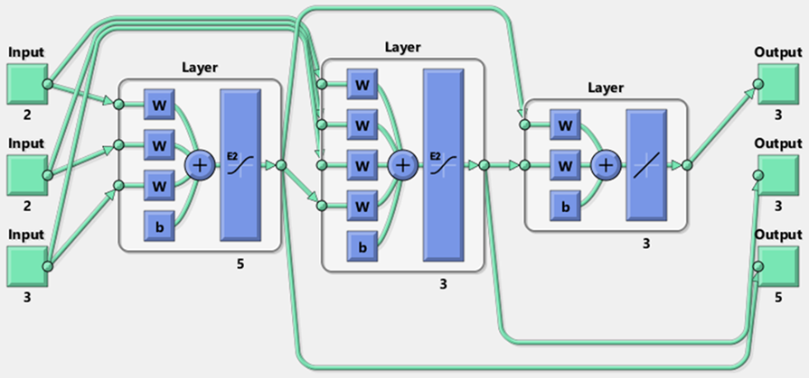
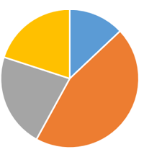
Using a partitioned equity circle to consider joint impacts of different variables
Internal Hierarchy
Lower & upper bound
Increasing Mixedness

Slide 20
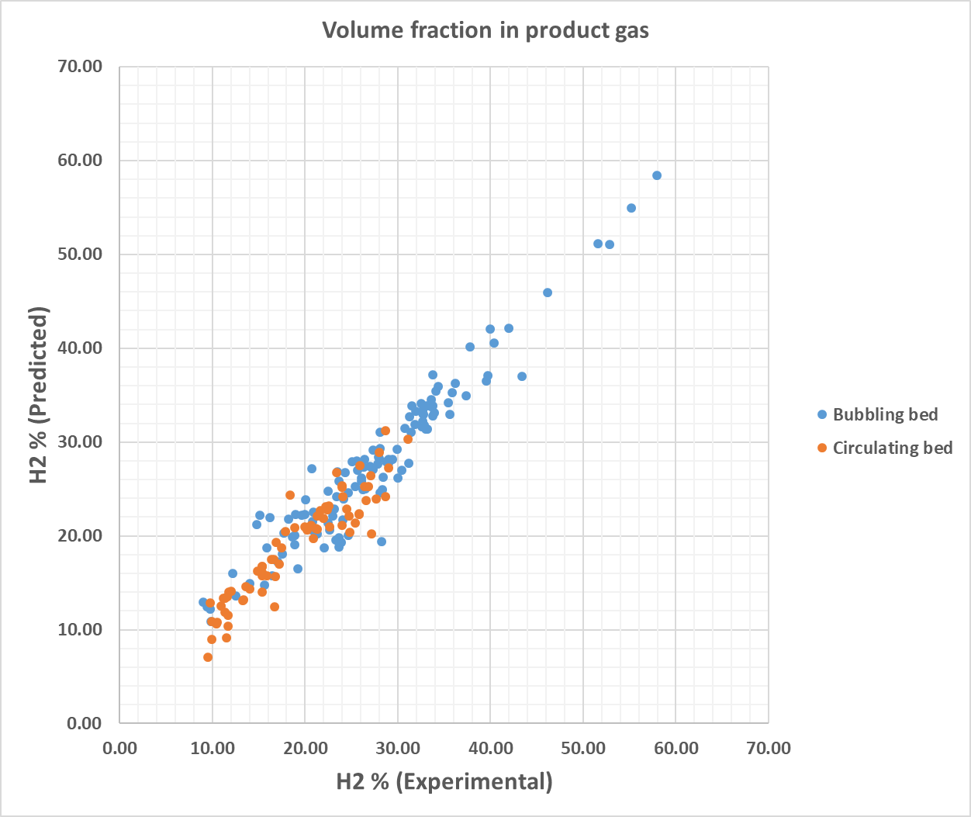
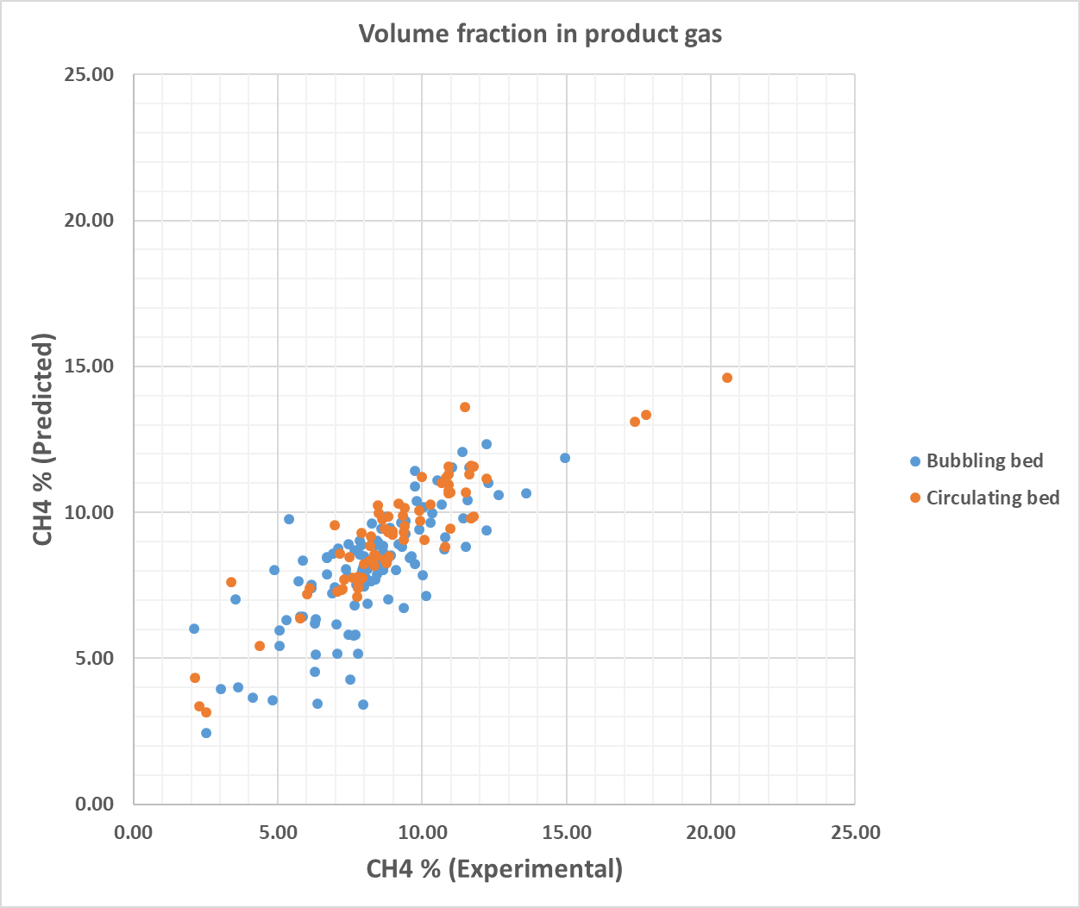
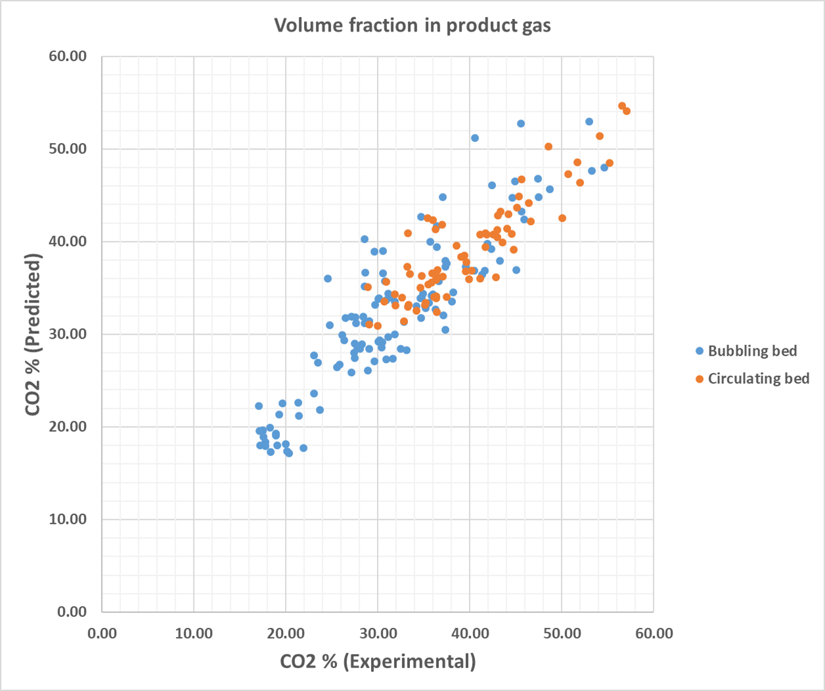
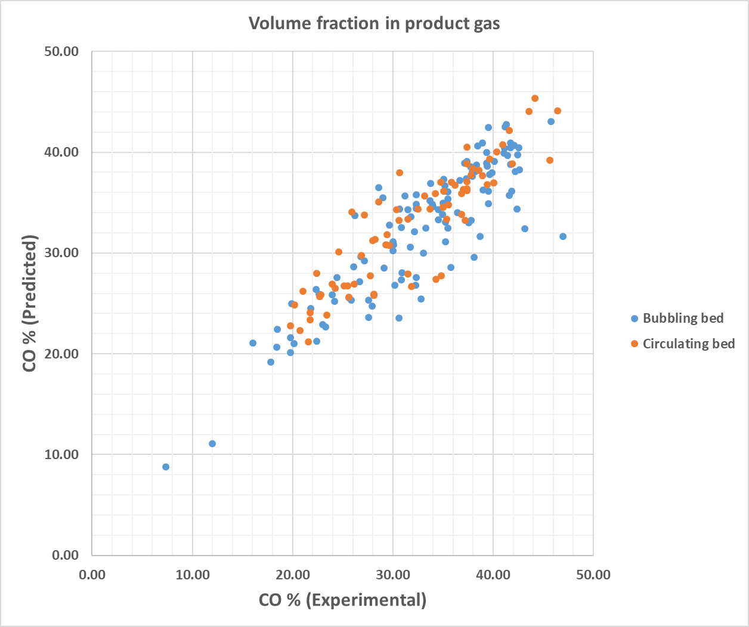
A Glance at predictions of the model vs experimental values
(Product gas composition)

Slide 21
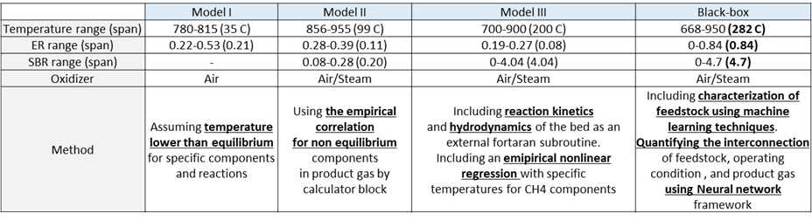
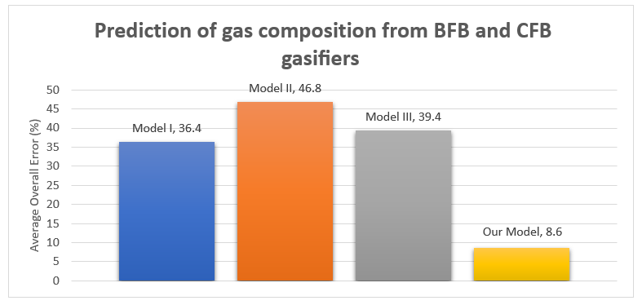
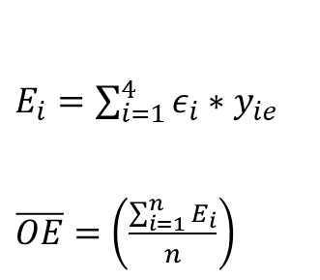

Slide 22
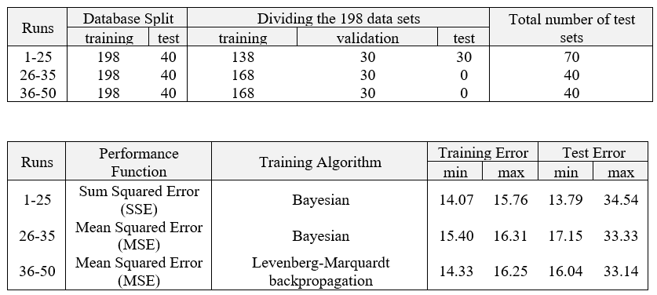
Search for the best model

Slide 23
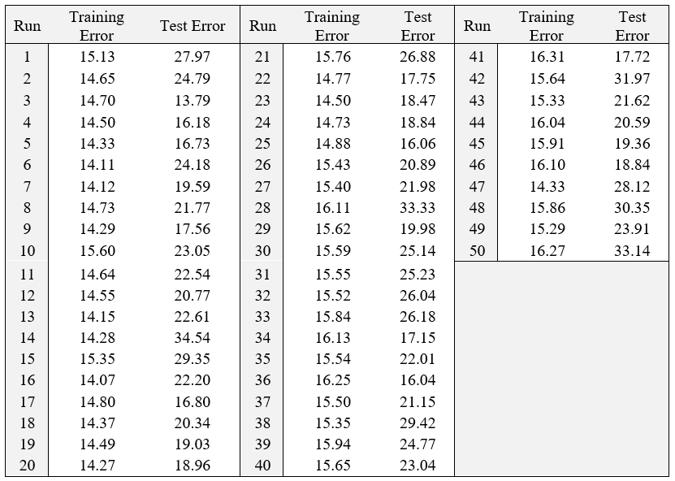

Slide 24
Development of CCE% &Yield modules
Constructing composite ensambles from:
Feed & O.C
Product Gas composition
Designing Fibonacci integer sequence representing input & output of an event
Designing three neural network based routes with different transfer fucntions to serve as a statistical inference tool
Performing algebriac calculations to obtain a characterstics matrix
Using a dynamical property value (specific computational time) & integration
Obtaining monotonic relationships for CCE & Yield from results of the integration.

Slide 25
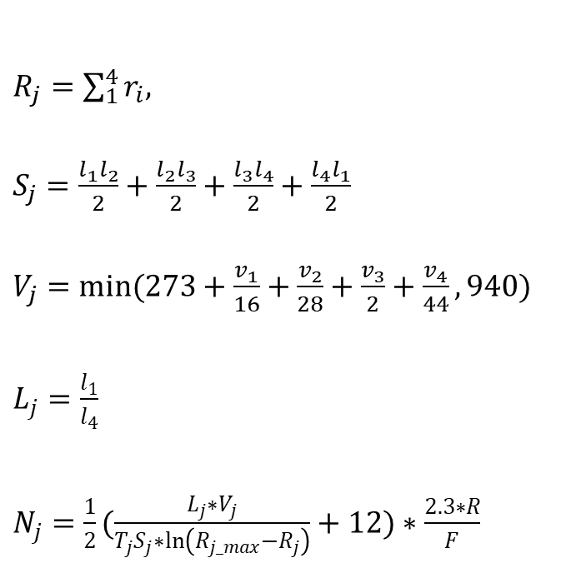





Ensemble Construction form
Feed & Operating condition
Internal Hierarchy
Lower & upper bound
Increasing Mixedness

Slide 26
Ensemble Construction form
Product gas composition
Internal Hierarchy
Lower & upper bound
Increasing Mixedness
Applying the same procedure to build the Ensemble Feed & Operating condition using volume fractions of H2, CH4, CO and CO2 for each dataset.

Slide 27





Harmonious Event Representative Groups
Feed+OC
Product gas

Slide 28















Quantification of Relative Responses from three routes
Linear
Hyperbolic Tangent Sigmoid
Elliot 2 Symmetric Sigmoid

Slide 29





Stationary Characteristic Matrix & Dynamic variable & Integration

Slide 30

Results of complete elliptic integral

Slide 31

Monotonic relationship for Yield (Nm3/kg) as a function of feedstock properties and operating condition

Slide 32
Monotonic relationship for CCE% as a function of feedstock properties and operating condition

Slide 33
Future work
“As of 2016 a rule of thumb is that a supervised deep learning algorithm will generally achieve acceptable performance with around 5000 labeled examples per category.”
Working successfully with small datasets is an important research area in machine learning. In that context, applying machine learning techniques to modeling physical processes is limited by limitedness of experimental data specially for expensive experiments such as gasification.
As far as the direction of research is concerned, additional improvements become feasible by resolving the following issues and alike:
“It is not clear now who at NETL really decides what multiphase research area to follow.”
“The Multiphase Fluid Dynamics Research Consortium (MFDRC) was established in 1998 in response to priority research needs identified in the Vision 2020 Computational Fluid Dynamics Roadmap.”
“That initiative is a model that should be followed if there is ever going to be an attempt to have a National Multiphase Computational Fluid Dynamics Initiative. With the current administration under President Donald Trump, the likelihood of this happening is precisely zero.”

Slide 34
Thank you for your attention
Questions?

Slide 35
Backup

Slide 36




Slide 37



Slide 38



































































































Abstraction of Justice
Full Connectedness &
Mulyiplicity of path
Guaranteed For All

Slide 39



Slide 40




نتایج انتگرال‌های کامل

Slide 41
CCE(%)

Slide 42


Slide 43


Slide 44


Slide 45


Slide 46


Slide 47


Slide 48


Slide 49


Slide 50


Slide 51


Slide 52


Slide 53


Slide 54


Slide 55


Slide 56


Slide 57


Slide 58





Slide 59





Slide 60



Slide 61



Slide 62
YIELD

Slide 63


Slide 64


Slide 65


Slide 66


Slide 67


Slide 68


Slide 69


Slide 70


Slide 71


Slide 72


Slide 73


Slide 74


Slide 75


Slide 76


Slide 77


Slide 78


Slide 79





Slide 80





Slide 81
Particle Size

Slide 82


Slide 83


Slide 84


Slide 85


Slide 86
Gasifier Type

Slide 87


Slide 88


Slide 89


Slide 90


